Slide 1
Predicting Genre using NLP
Manda Bucklin

Slide 2
The Data
380,000+ lyrics from the website MetroLyrics.com
Name of Song, Year, Artist, Genre, and Full Lyrics of Song
10 different Genres
Pop, Rock, Hip-Hop, Metal, Country, Electronic, Jazz, R&B, Indie, & Folk
We removed “Other” genre
Year range: 1960-2016

Slide 3
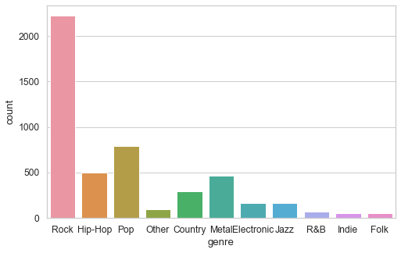
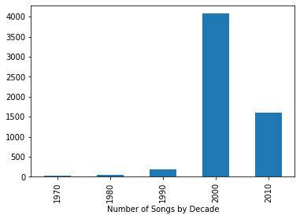
Data Exploring

Slide 4
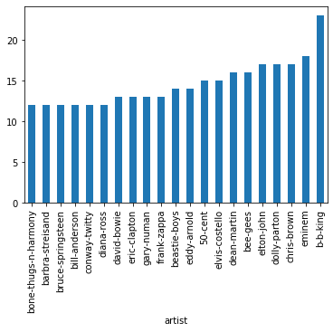
Data Exploring (cont’d)

Slide 5
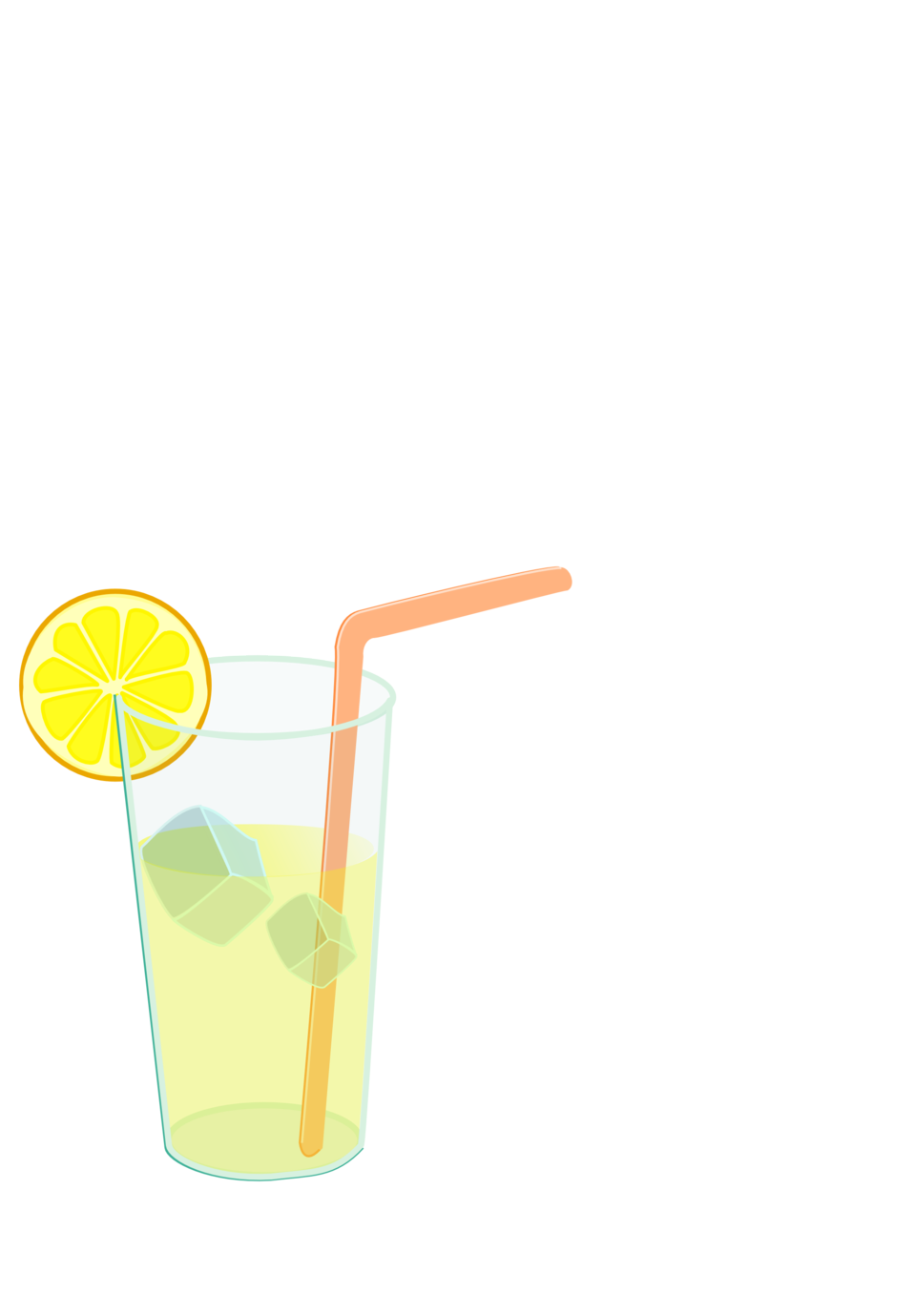
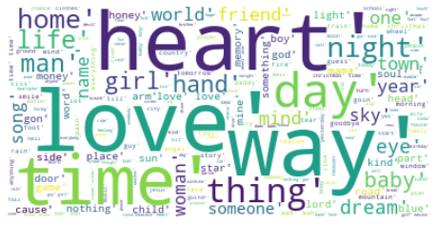
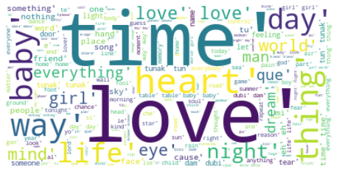
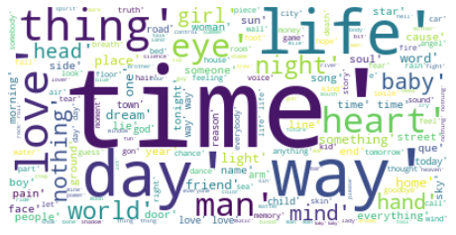
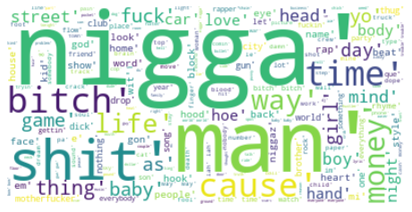
Lyrical Lemonade
Country
Pop
Rock
Hip-Hop

Slide 6
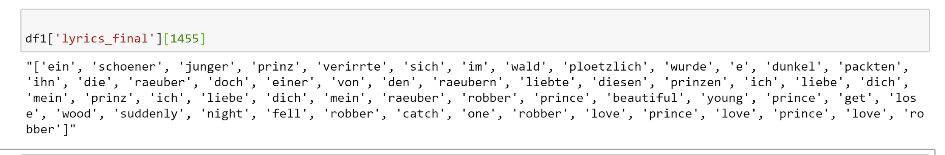
Questions we must ask
If genres share many similar words, how can we predict the correct one?
How do we break-down the lyrics to the most suitable form?
Potential Issues with data:
Songs are categorized by artist’s genre not song’s genre
Dealing with multiple languages in one song
Skewed data because of number of songs in each genre and the amount of songs from a particular year.

Slide 7
First: Clean up lyrics Column
Make all lyrics lowercase
Remove Stop-Words
Nltk English, Spanish, Portuguese, and German Stopwords
and custom words (by me)
Tokenize Words
Word tokenization splits the text into individual words.
Example: "oh love, how you doing?" into a list with the tokens ['oh',love’, ",",'how','you','doing','?'].

Slide 8
Tokenization in Action

Slide 9
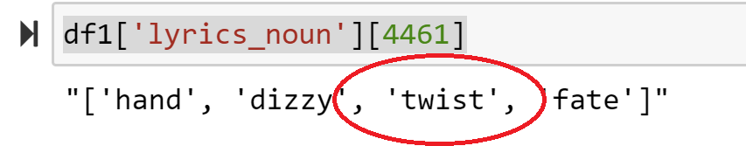
Next, Lemmatization
What is Lemmatization?
Converts a word to its base form.
This involves grouping together different inflected forms of a word, while still keeping the context of the word (i.e. is it a noun, verb, adjective).
Why Lemmatization?
Allows us to group together the inflected forms of a word so we can analyze them as a single item.
Words with multiple variations, but with similar meanings, can be analysed as a single item. An example of this is "better" to "good", "saying" to "say", and "heard" to "hear".

Slide 10
To recap:
Original
Tokenization
Lemmatization

Slide 11
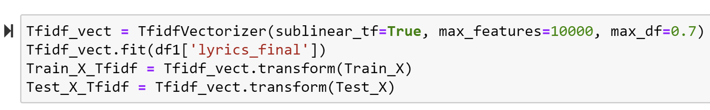
Split data and Implement TFIDF
What is TFIDF
term-frequency x inverse document-frequency
Measuring “originality” of word
TFIDF takes an occurence of a token (i.e. a lemmatized word) in the data and scales down the impact of these tokens that occur very frequently in our data. In our example, this means a lemmatized word would be "less informative" if it occurs more frequently across all genres.
What does it do?
.fit() - fits the vocabulary and term frequencies of word-vector
.transform() - using "fit()" calculation parameters, apply the transformation to a dataset.

Slide 12
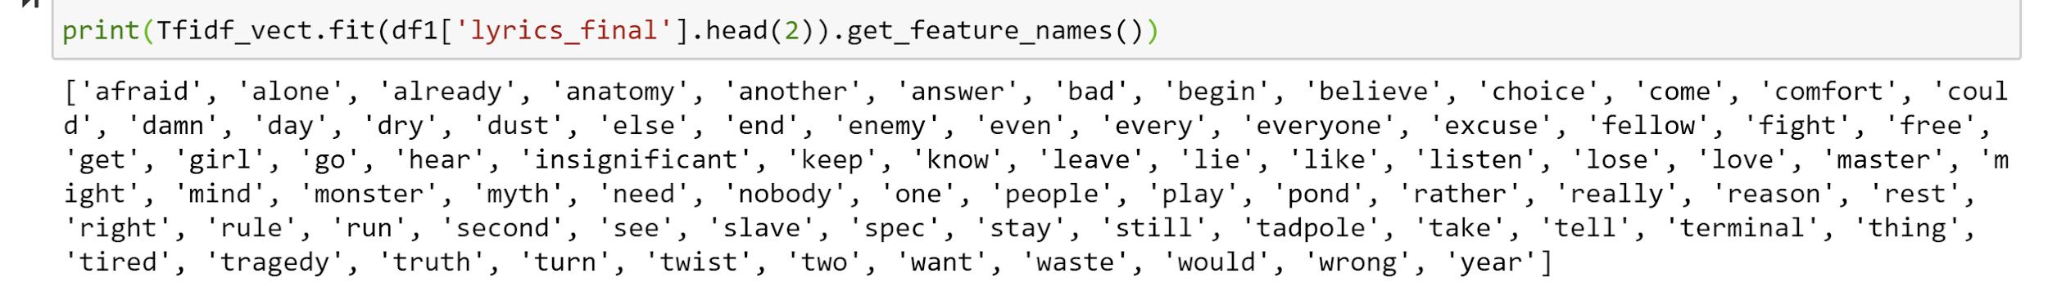
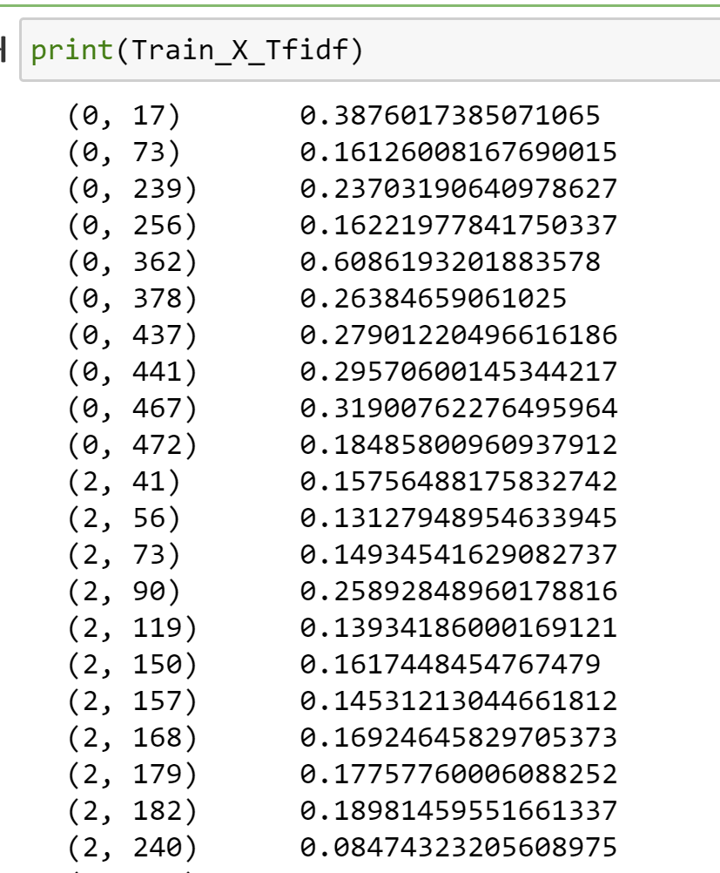
TDIF in Action
Column1: Document index (song lyrics)
Column2: Specific word-vectors (lemmatized word in lyrics)
Column3: TFIDF score ("originality score") for word in lyrics

Slide 13
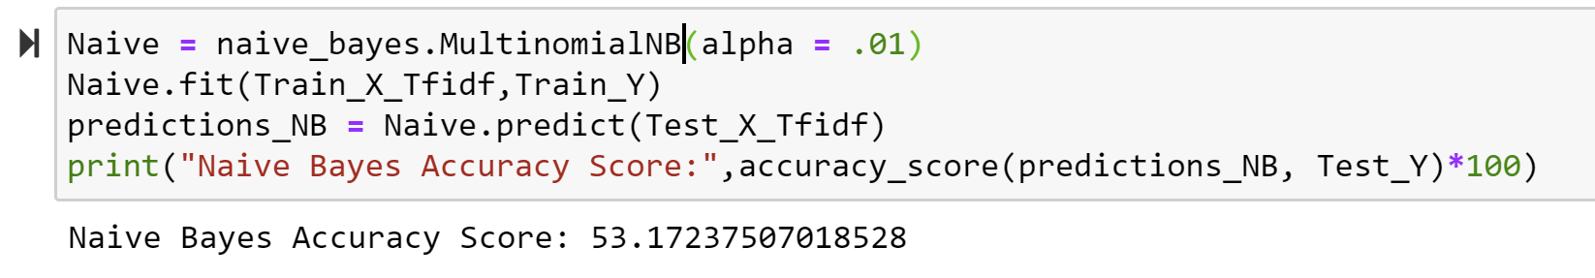
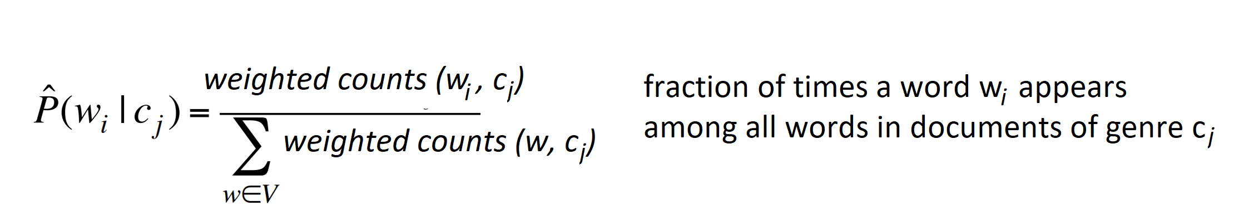
Predicting Genre
Using Naive Bayes
We use sum of TF-IDF-values for a genre.
TF-IDF (since it is a term-weighted method) gives Naive Bayes better information about the importance of the feature.

Slide 14
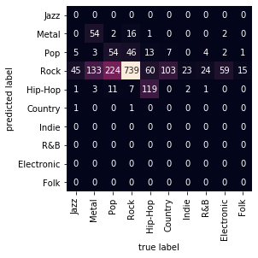
Why only 53% Accuracy?
Limitations of data
Few Folk and Jazz songs
Because songs were categorized by artists’ genre as opposed to song genre, perhaps some Rock songs are more like Country, Metal or Pop.
Overlap of Genres
Differences between Rock and Pop/Country/Metal

Slide 15
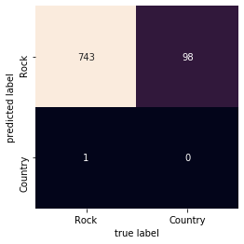
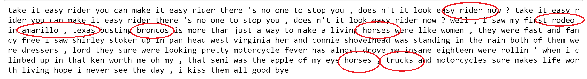
Overlap of Genres: Country vs Rock
Country vs Rock Confusion Matrix
I wanted to know why almost all Country songs were misclassified as Rock songs
I filtered the misclassified data to only view Country songs which were predicted Rock
While some songs seemed indistinguishable from Rock or Country, some songs were obvious
Country Song Misclassified as Rock Song:

Slide 16
Overlap of Genres: Country vs Rock (cont’d)
What could have caused such bad misclassification?
Add more Country songs in dataset
Issue with lemmatization of words
Lemmatization doesn’t take phrases into account
“Country road” vs. “country” & “road”
“Chillin on a dirt road” vs “chill” “dirt” & “road”
Phrase context vs individual words and their parts of speech
Test Ourselves: are these lyrics Country or Rock?

Slide 17
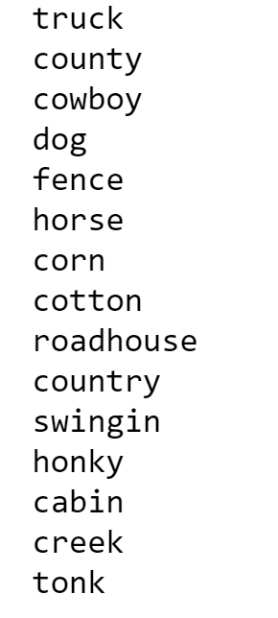
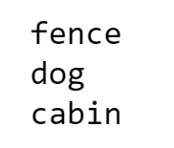
Improving Country vs. Rock
In Country lyrics In Rock Lyrics
Word weight
Adding more weight to words that were clearly more Country: (i.e. rodeo, honky tonk, cotton, truck, cotton, etc).
For example, these words are more Country than Rock. To prove there was a difference in usage of certain nouns, I looped through the Country and Rock TFDIF_Vecotizer.vocabulary to view which words were used in the dictionary I created.
I tried to add weight to particular words, but unfortunately did not have time to successfully implement it.

Slide 18
Improving Pop vs Rock
Pop vs Rock Confusion Matrix
I wanted to know why certain Pop songs were misclassified as Rock songs
I filtered the misclassified data to only view Pop vs Rock errors
After much confusion, and after reading the internet for a few hours, I realized that Rock music is a broad genre of Pop music. The “Pop vs Rock music” argument has more to do with the instruments used and melodic style created.
Nevertheless, if I had more time I would try to utilize the year the song was created and create more genre specific word banks for Rock and Pop.

Slide 19
Questions?

